Slide 1
An African Restaurant
In London
How to predict the best area in London to open it?

Slide 2
The idea of this capstone project is to help those people to know the best location in London to have a good revenue at the end.
The problem is the big area of London which has 8 different areas as following: South East, South West, West, North, East Central, East, West Central, and North West.
There is a high multicultural sense.
There are many fine restaurants in London – African, Asian, Middle Eastern, Latin and American restaurants.
Introduction
The Business Problem

Slide 3
Create the dataframe of London by using the postcodes of London from wikipedia , different kind of data for example:
the PostCode,
the Name of the Neighborhood,
the Area,
and the Area Category to determine the 5 areas of London
The process of cleaning the data will be used to clean all venues not included in the PostCode column.
Combining the data of current restaurants in London areas with the data will be used from the Foursquare location data to extract the venues information for the areas of interest
Grouping the neighborhood in 5 clusters based on different numbers of facilities that are there in that area.
At the end of this project, I will be going to use folium library to create the necessary maps in order to give a visual view to those people of the best location to be used.
Data Will be Used
Data acquisition and cleaning

Slide 4
Methodology
The way to implement the project
Proceed in data analysis to find the best area and neighborhood to open the restaurant.
From the Foursquare data I will take into consideration the top common venues in that area, and this can be implemented through frequency statistics and aggregations per area and derive the distributions per area and per venue category.
At that point we had to choose the best area of London and we selected the area with the minimum number of restaurants and this will be implemented in two stages:
the first stage is to selected the top 20 restaurants in the area
the next stage is to select the top 10 restaurant then I will proceed in K-means clustering method in order to group our neighborhoods into 5 clusters based on the venues nearby.
Geospatial map view will be used to represent the results.
The last step is exploring the derived clusters to choose the cluster that there is a probable opportunity to open restaurant after determining the optimal neighborhood based on the least percentage of restaurants and the distance between the new restaurant to other restaurants in the area and other entertainment venues nearby if any.

Slide 5
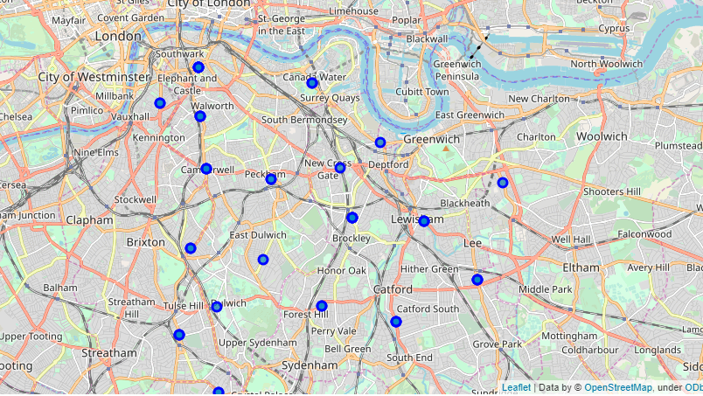
Neighborhoods
The South East London neighborhoods are then superimposed on top

Slide 6
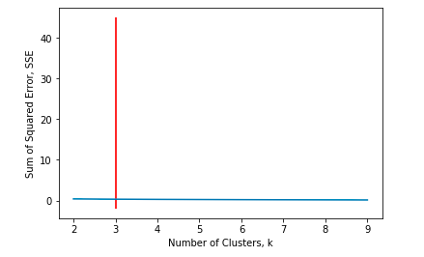
The Optimal Number of Clusters for K-mean

Slide 7
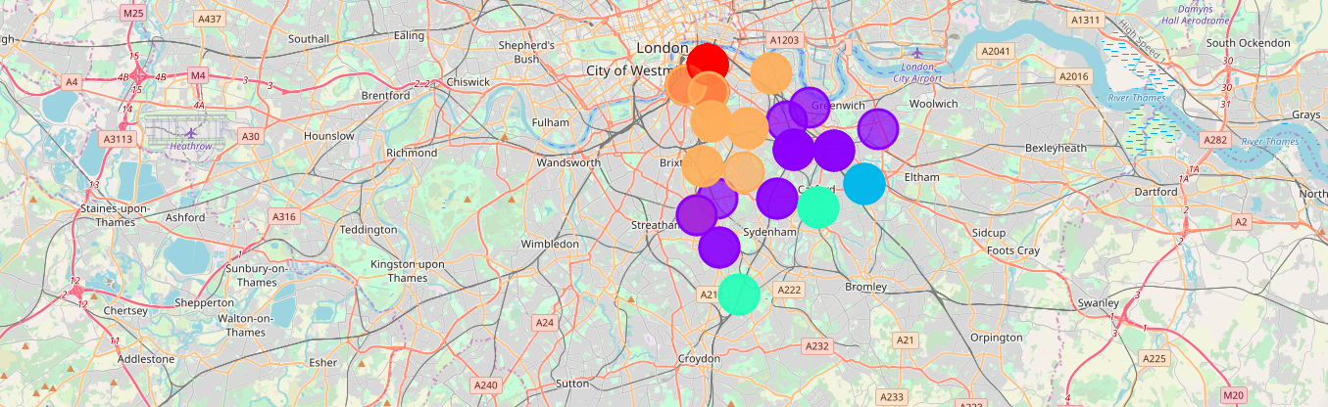
The highest Silhouette Coefficient gives the best match to its own cluster.

Slide 8
To conclude the observation while working on this project in order to determine the best area to open the restaurant in London, I can summary the observation as following:
There were lots of restaurants and food industries in London. • There were lots of special non geolocation postcodes that correspond to food and other facilities in the data. • Many factories used in this project to determine the best location/area to open the restaurant such as the number of food restaurants nearby, distance from central London and if there are other facility venues nearby.
Discussion
Based on the data we used

Slide 9
The following are the results from analyzing the above 5 clusters :
Pubs, Cafe, Coffee Shops are popular shops in the South East London.
The Italian Restaurants are very popular in the South East London area (Especially in Southwark and Lambeth areas).
Lewisham area is the most condensed area of Africans in the South East Area.
Results
Based on Data Analysis

Slide 10
From the results we can conclude that Clusters 2 and 3 are the most viable clusters to create an African Restaurant. Their proximity to other amenities and accessibility to station are paramount. The proximity to resources needed is paramount as Lewisham and Lambeth are not far out from Peckham (under Southwark). More factors can affect the results if included in this project, for example, more facilities near the area we will open the African restaurant, the traffic access, hotels, and also the feed back of people on other African restaurants if any.​
Conclusion

